Slide 1
CSC102 Object Oriented Programming
Project Final
Submission

Slide 2

MAD Creationzz online fashion store Always in Style !!!

Slide 3
Team Members
Roll No. | Name | Programme
AU1841017 | Miracle Rindani | B.Tech ICT
AU1841004 | Aanshi Patwari | B.Tech ICT
AU1841052 | Dipika Pawar | B.Tech ICT

Slide 4
Problem Definition
It will help the individual shopkeepers spread their business through the portal.
To help the customers shop online with a variety of clothes availability with no need to go out for shopping.

Slide 5
Objective and End-Users
Objective
To make shopping clothes easy for people and help the individual shopkeepers of the city spread their business.
Software End Users
Admin and Customers

Slide 6
Functionalities
Admin User
1) Manage Customer Record – Track customer activity, clothes purchased
2) Manage Stock Record - Stock availability ,
stock transaction details

Slide 7
Functionalities
Customer
1) Customer login / sign up options
2) Search clothes by category (Men/ Women/ Kids)
3) Sort and filter clothes according to colour, price etc.
4) Add to cart / Remove from cart
5) Confirm the order
6) Payment and Delivery details
7) Generate payment slip
8) Sign out
9) Rate and/or comment on the purchased products

Slide 8
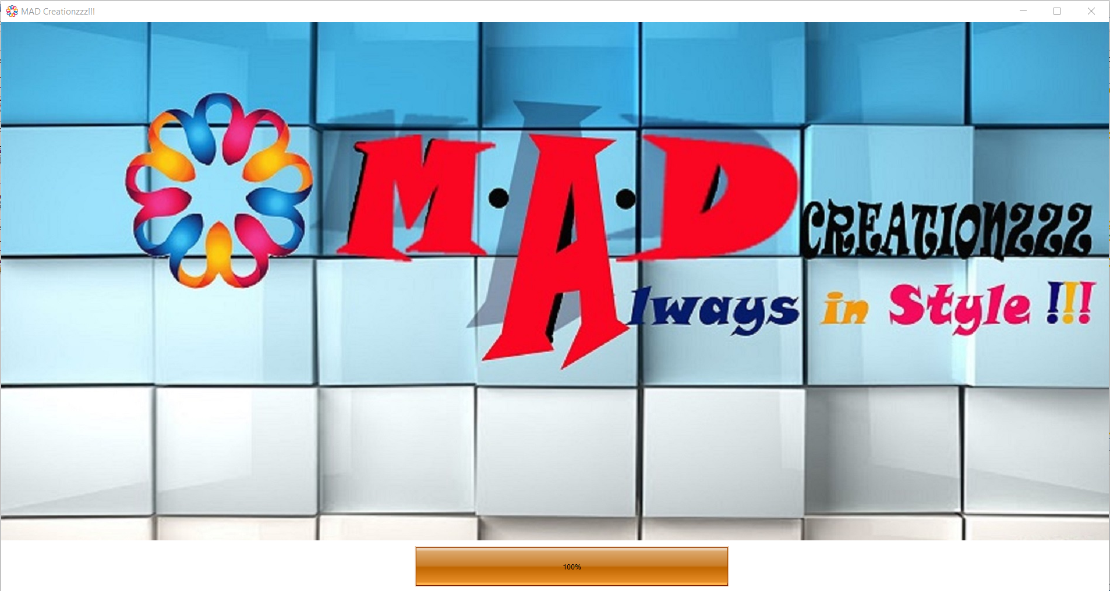
GUI/Screen Design
Front Screen

Slide 9
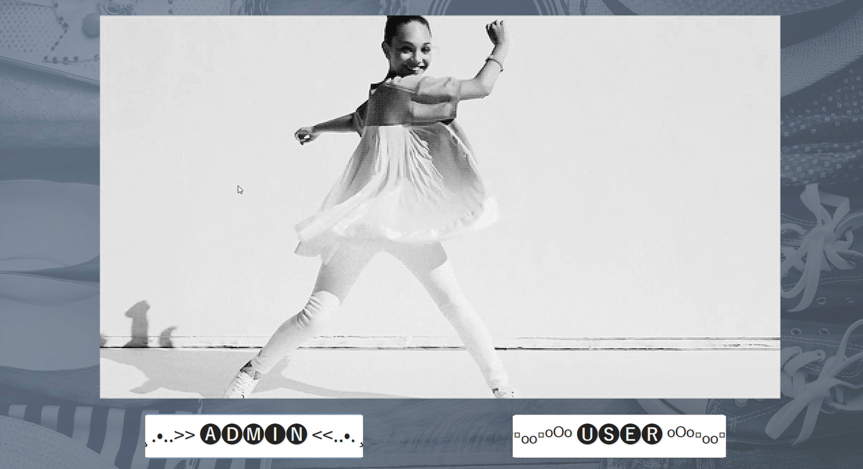
GUI/Screen Design
Login Screen (GIF VIDEO)(Please play)

Slide 10
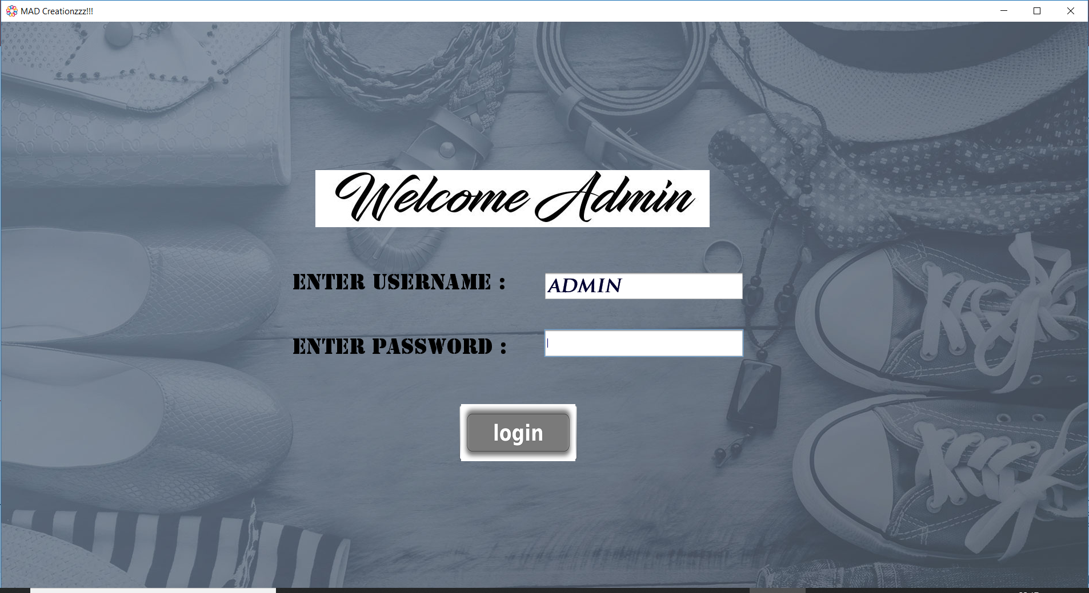
GUI/Screen Design
Admin Login Screen

Slide 11
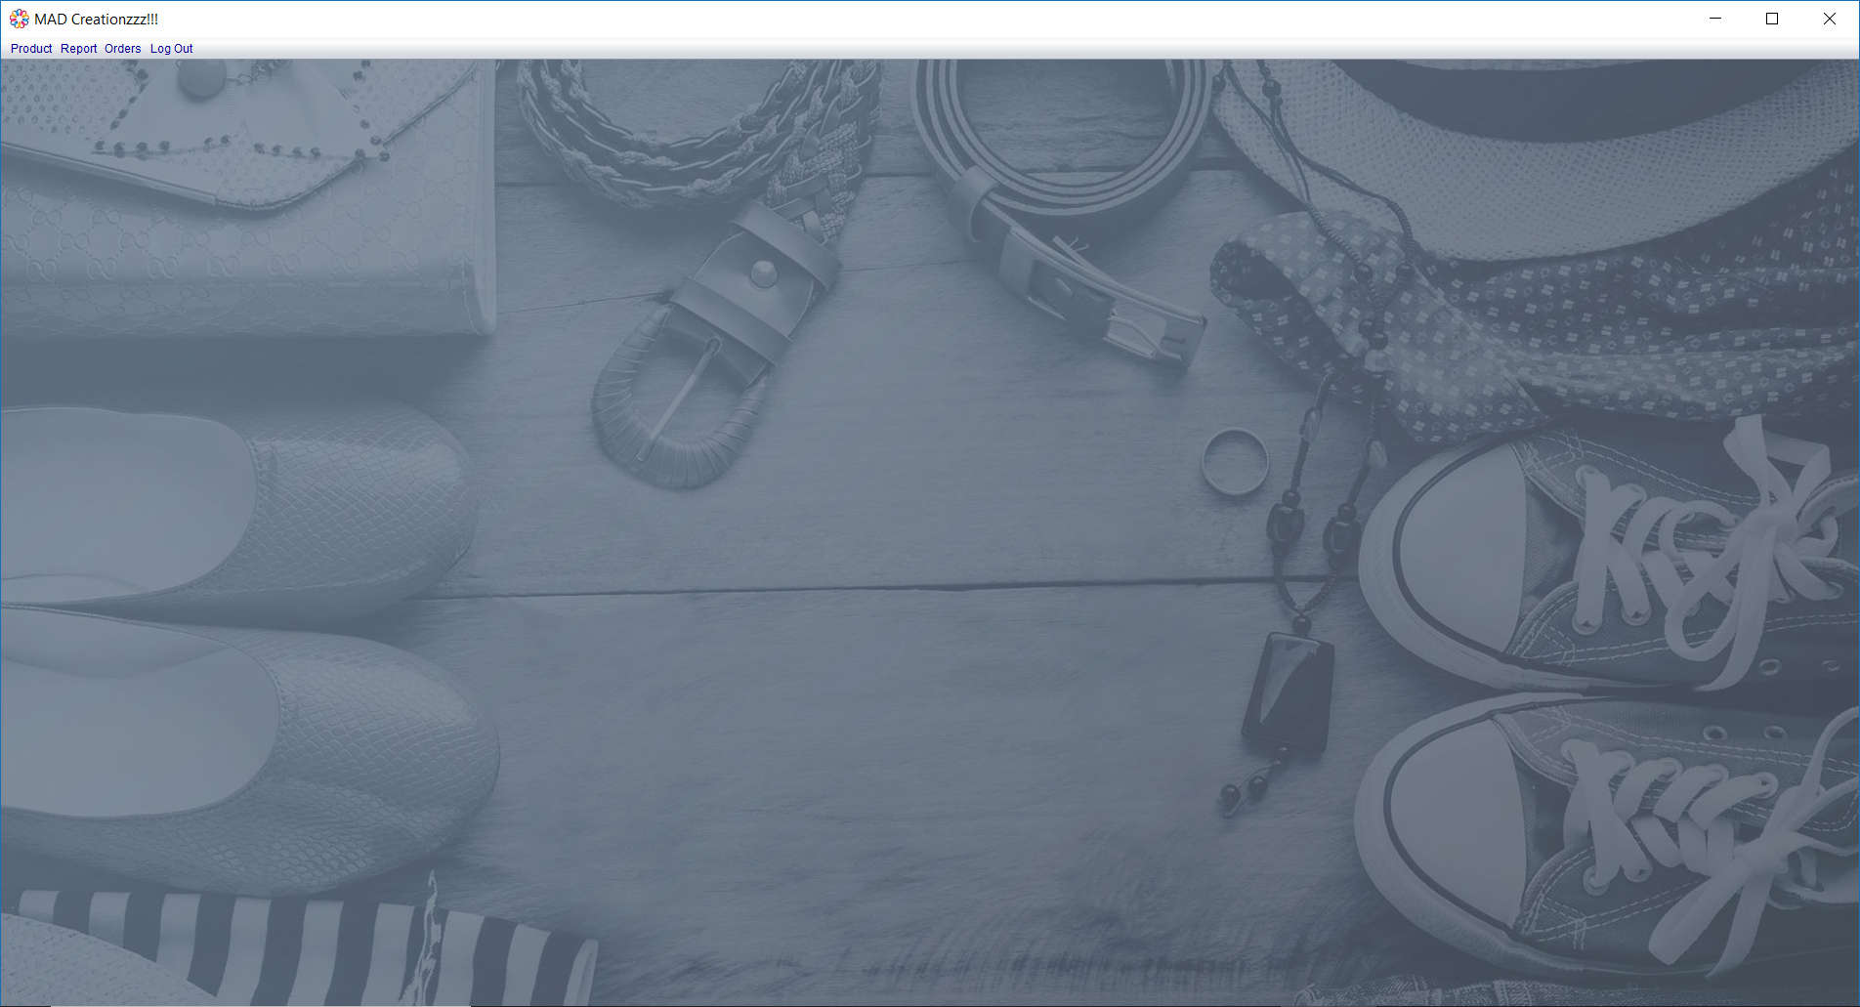
GUI/Screen Design
Admin Dashboard Screen

Slide 12
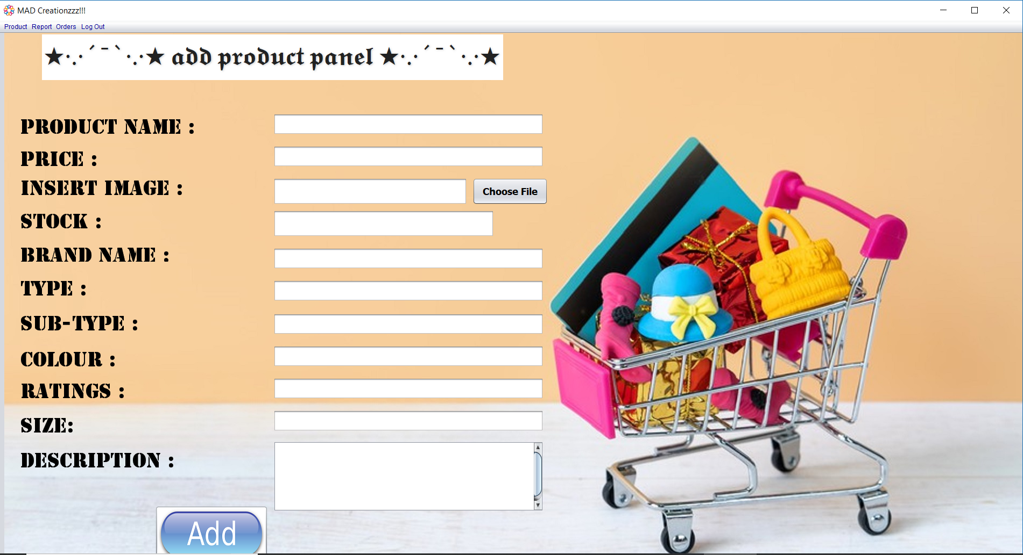
GUI/Screen Design
ADD PRODUCT Screen

Slide 13
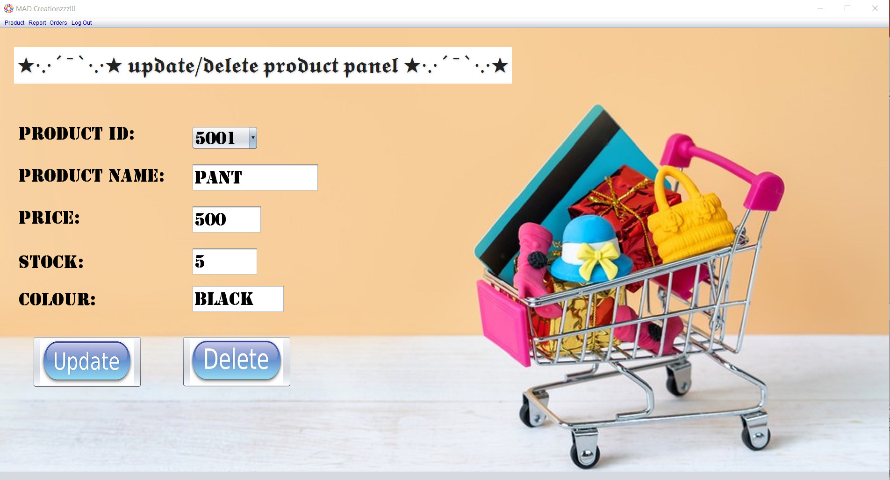
GUI/Screen Design
UPDATE PRODUCT Screen

Slide 14
GUI/Screen Design
DELETE PRODUCT Screen

Slide 15
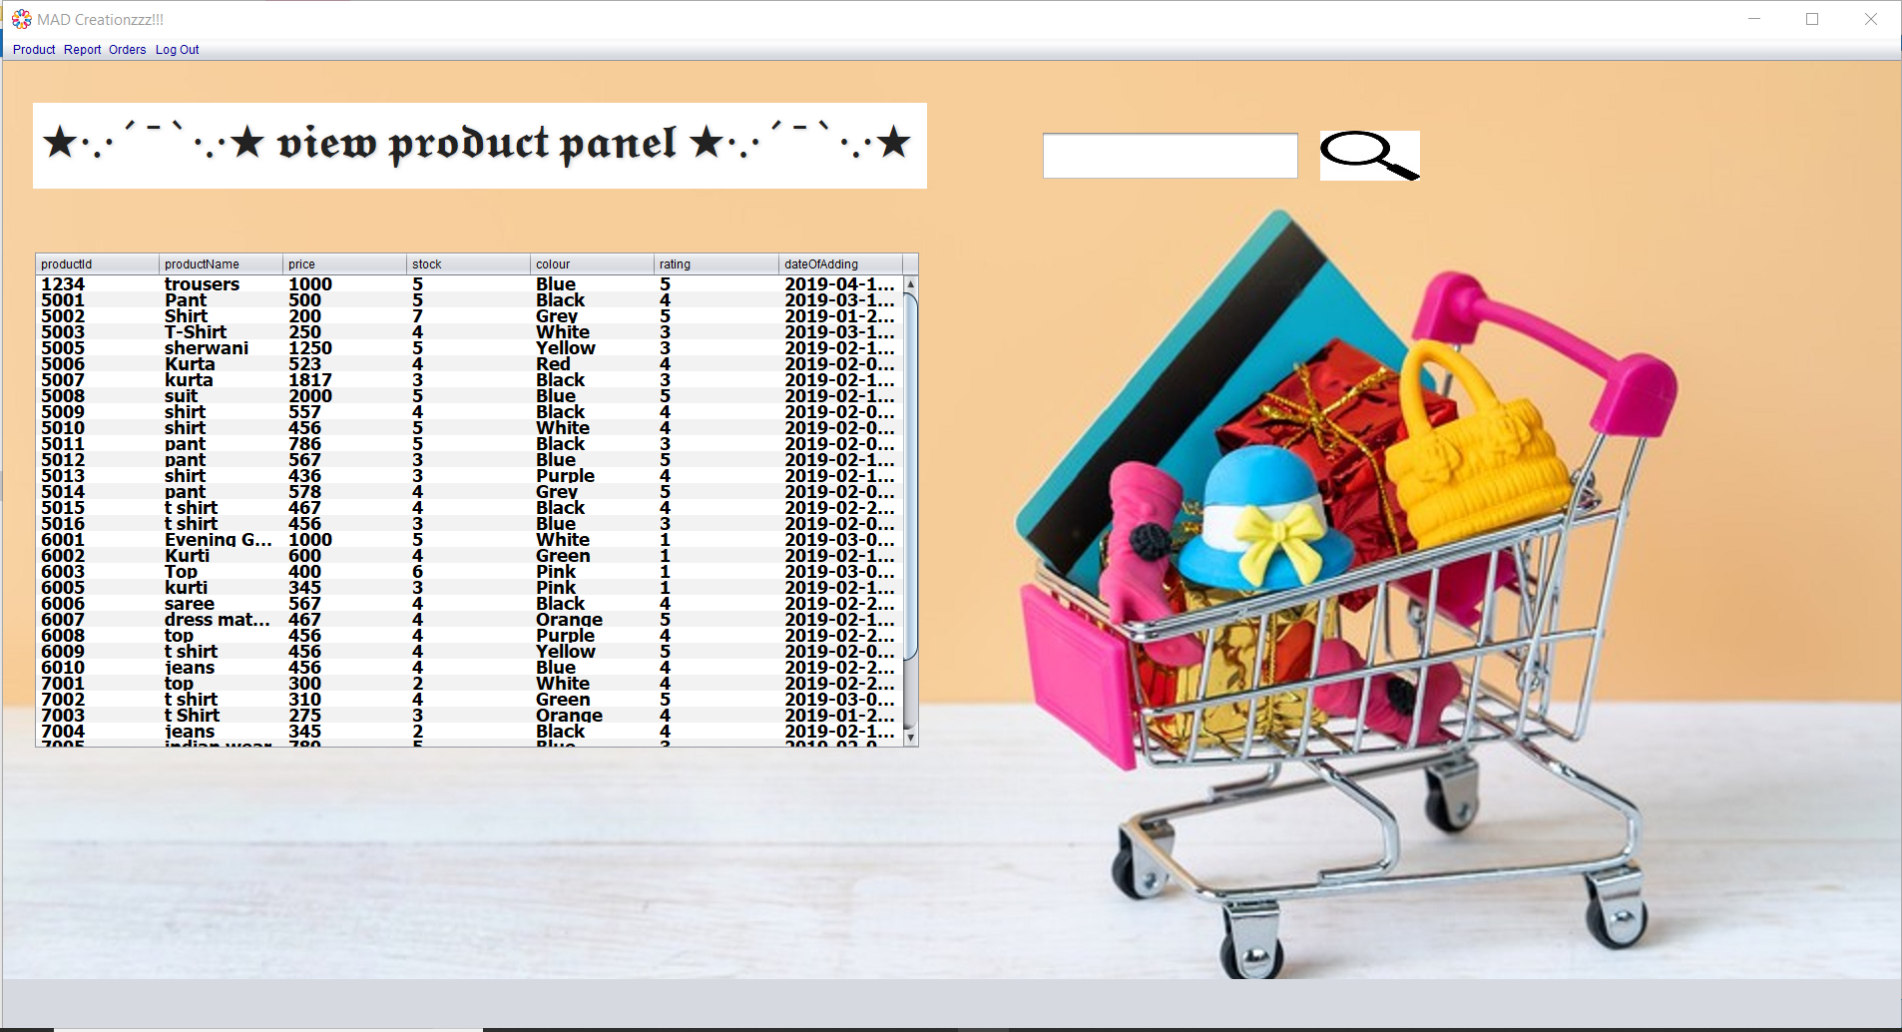
GUI/Screen Design
VIEW PRODUCT Screen

Slide 16
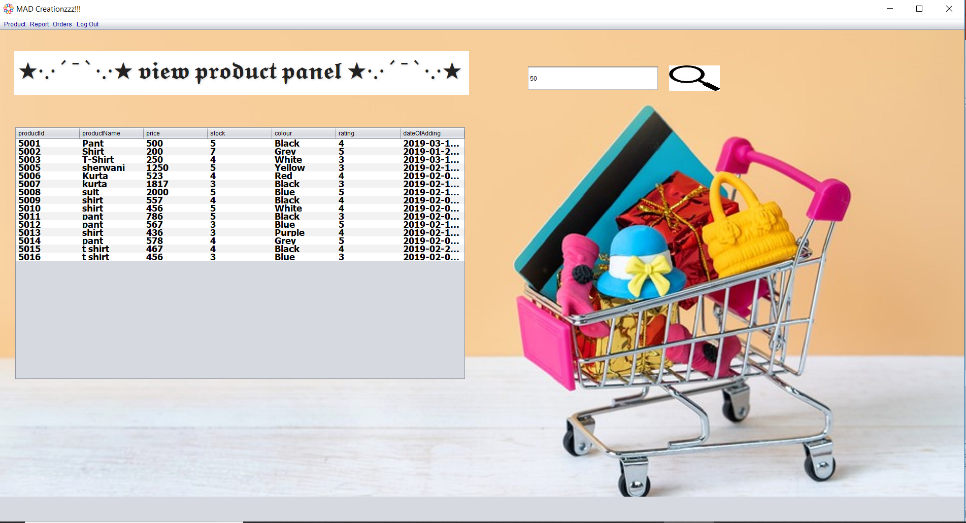
GUI/Screen Design
VIEW PRODUCT Screen

Slide 17
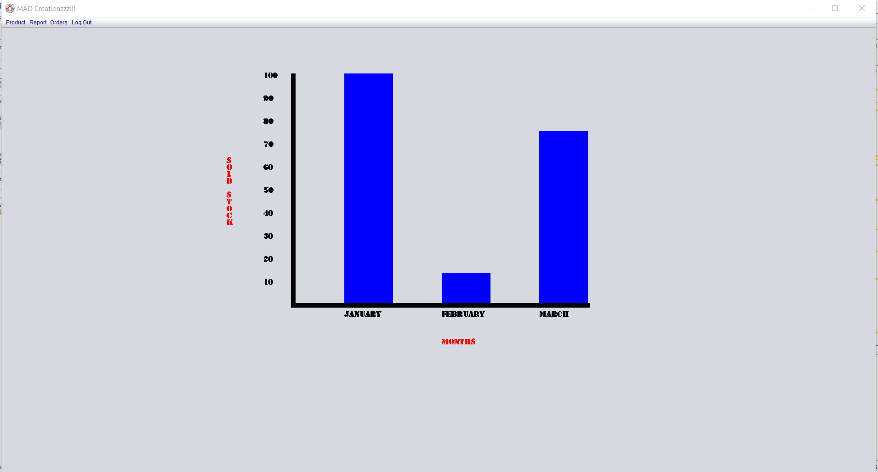
GUI/Screen Design
Report Screen

Slide 18
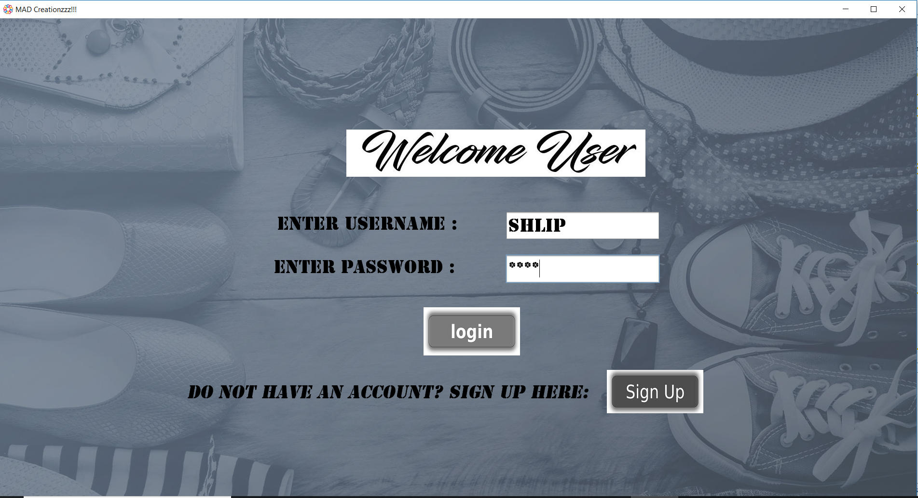
GUI/Screen Design
User Login Screen

Slide 19
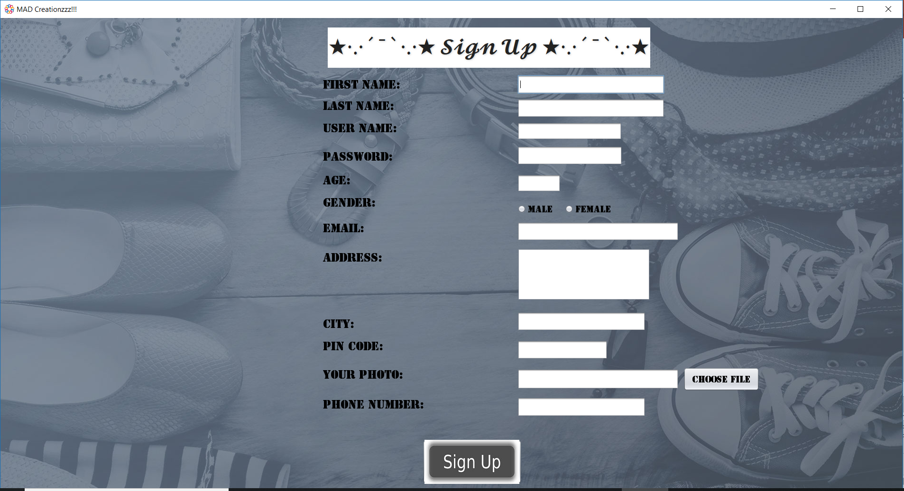
GUI/Screen Design
User Sign-Up Screen

Slide 20
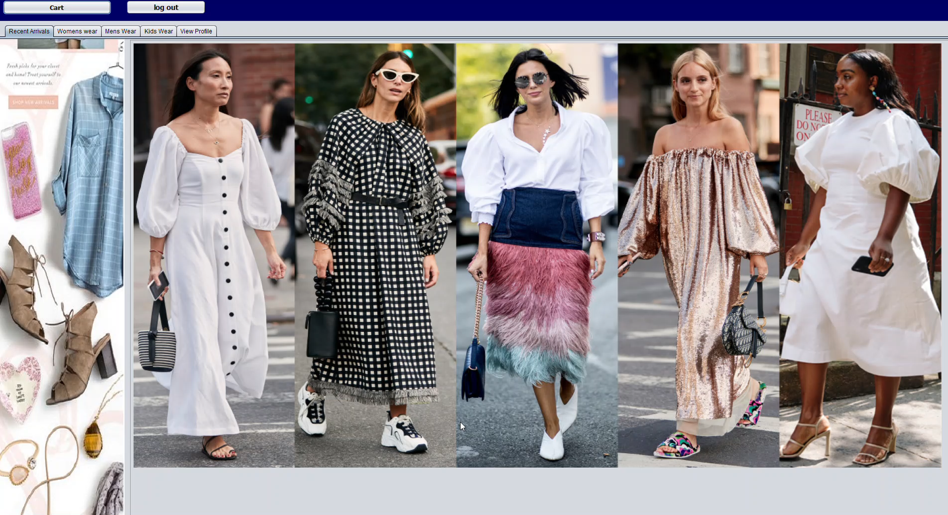
GUI/Screen Design
Customer Dashboard Screen
(Please play the video)

Slide 21
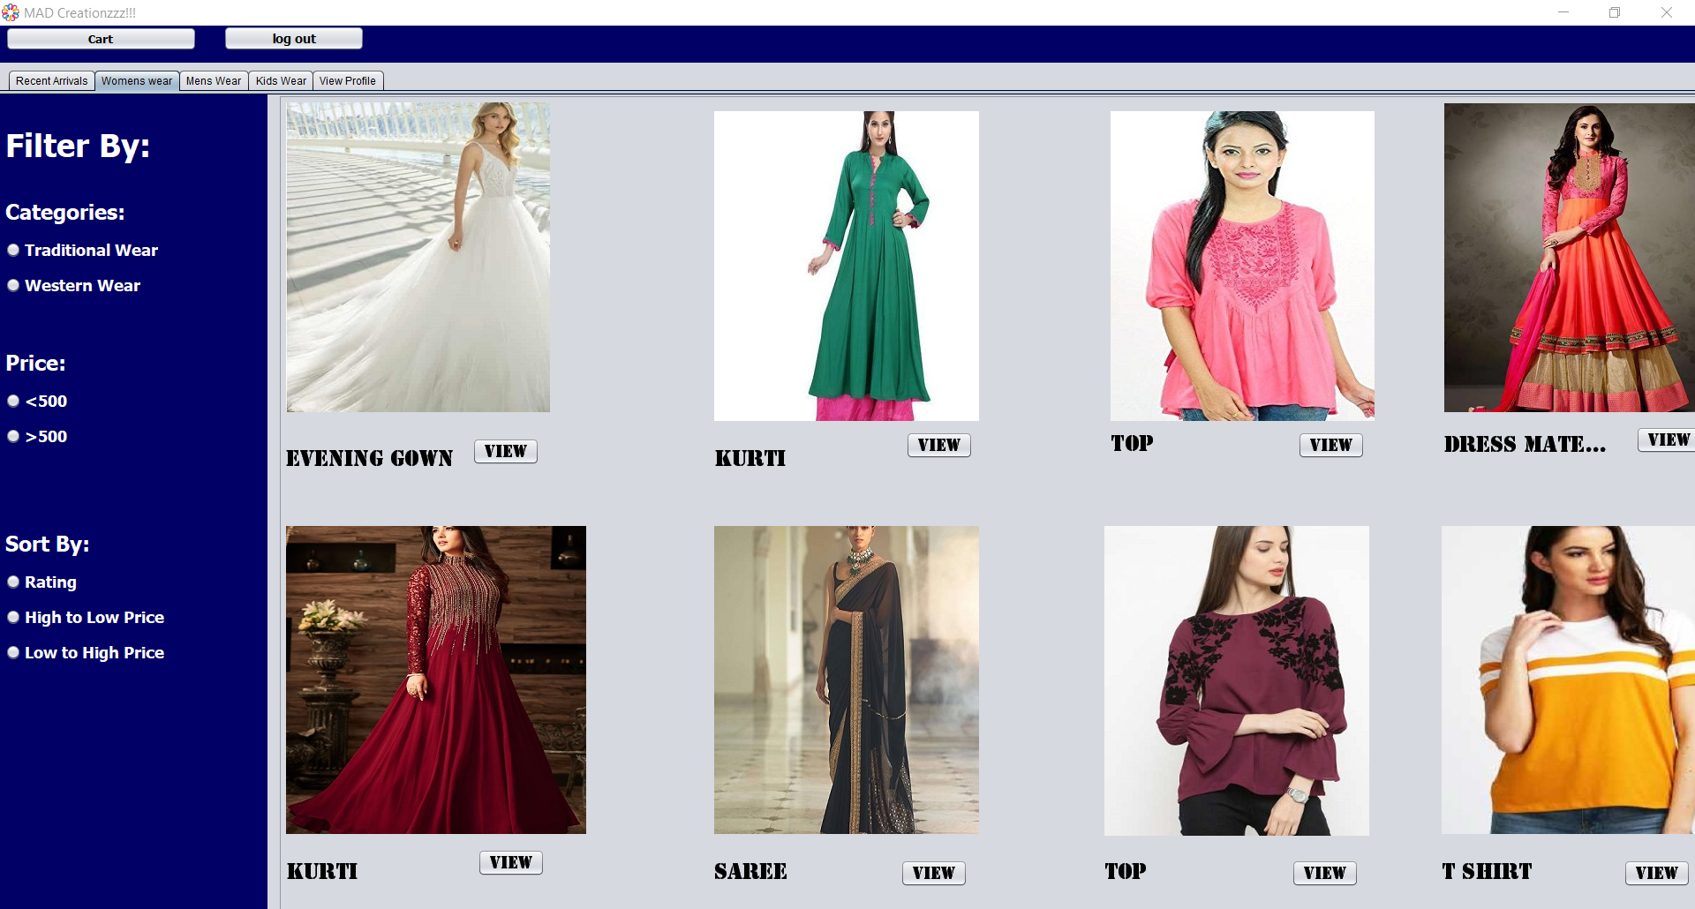
GUI/Screen Design
Women's Wear Screen

Slide 22
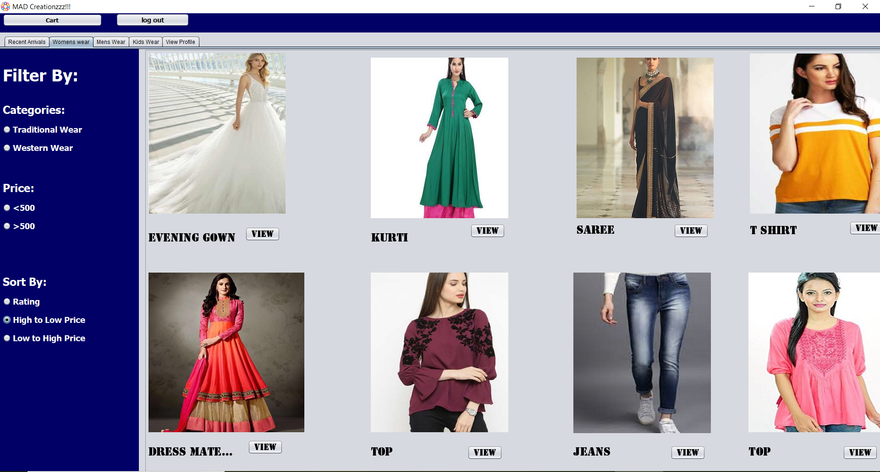
GUI/Screen Design
Women's Wear Screen

Slide 23
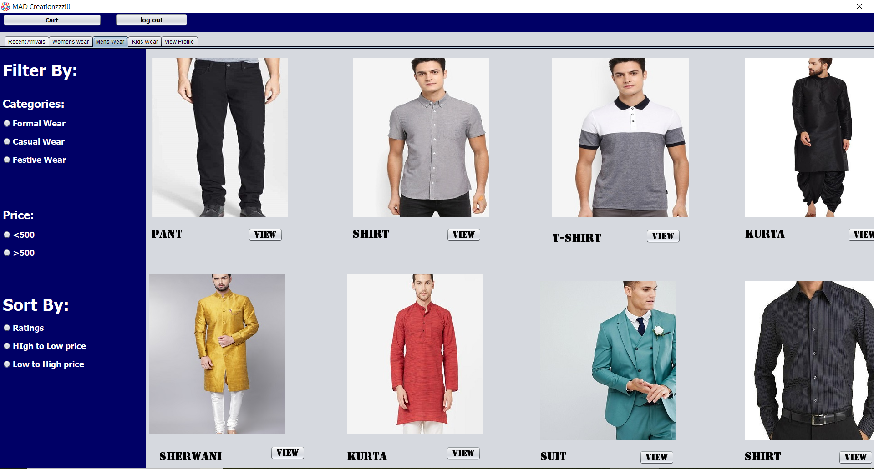
GUI/Screen Design
Men's Wear Screen

Slide 24
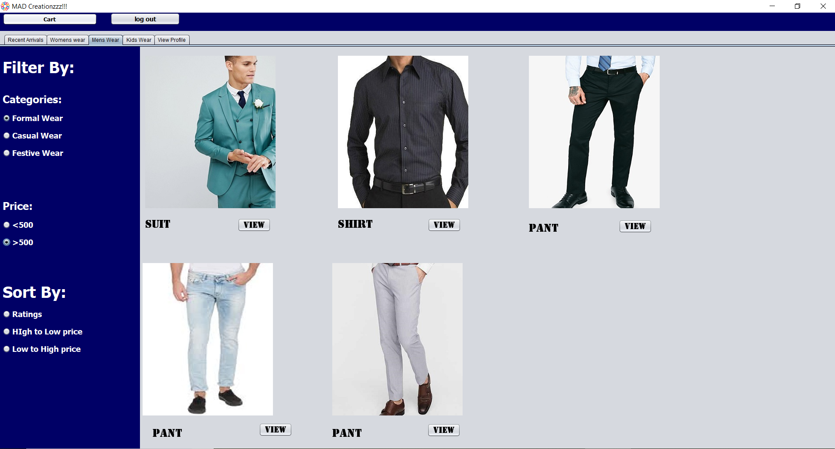
GUI/Screen Design
Men's Wear Screen

Slide 25
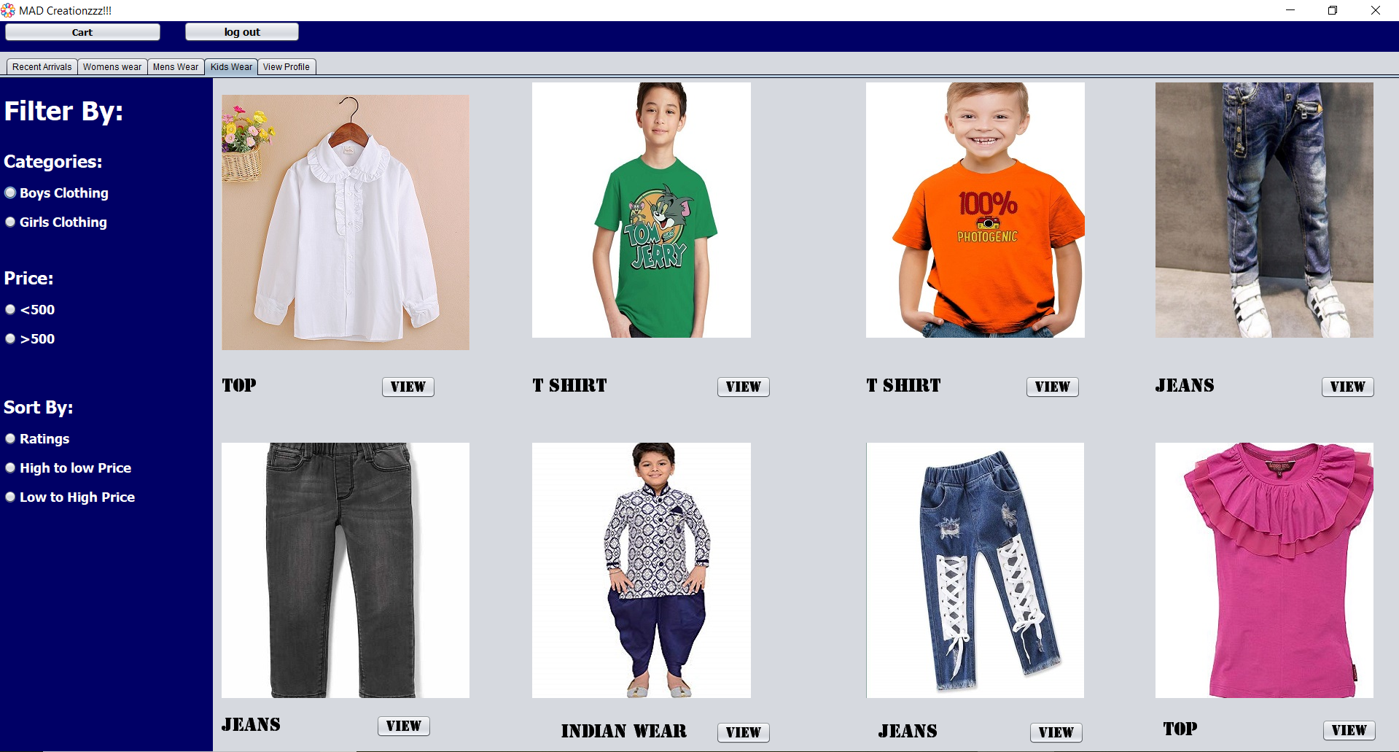
GUI/Screen Design
Kids’ Wear Screen

Slide 26
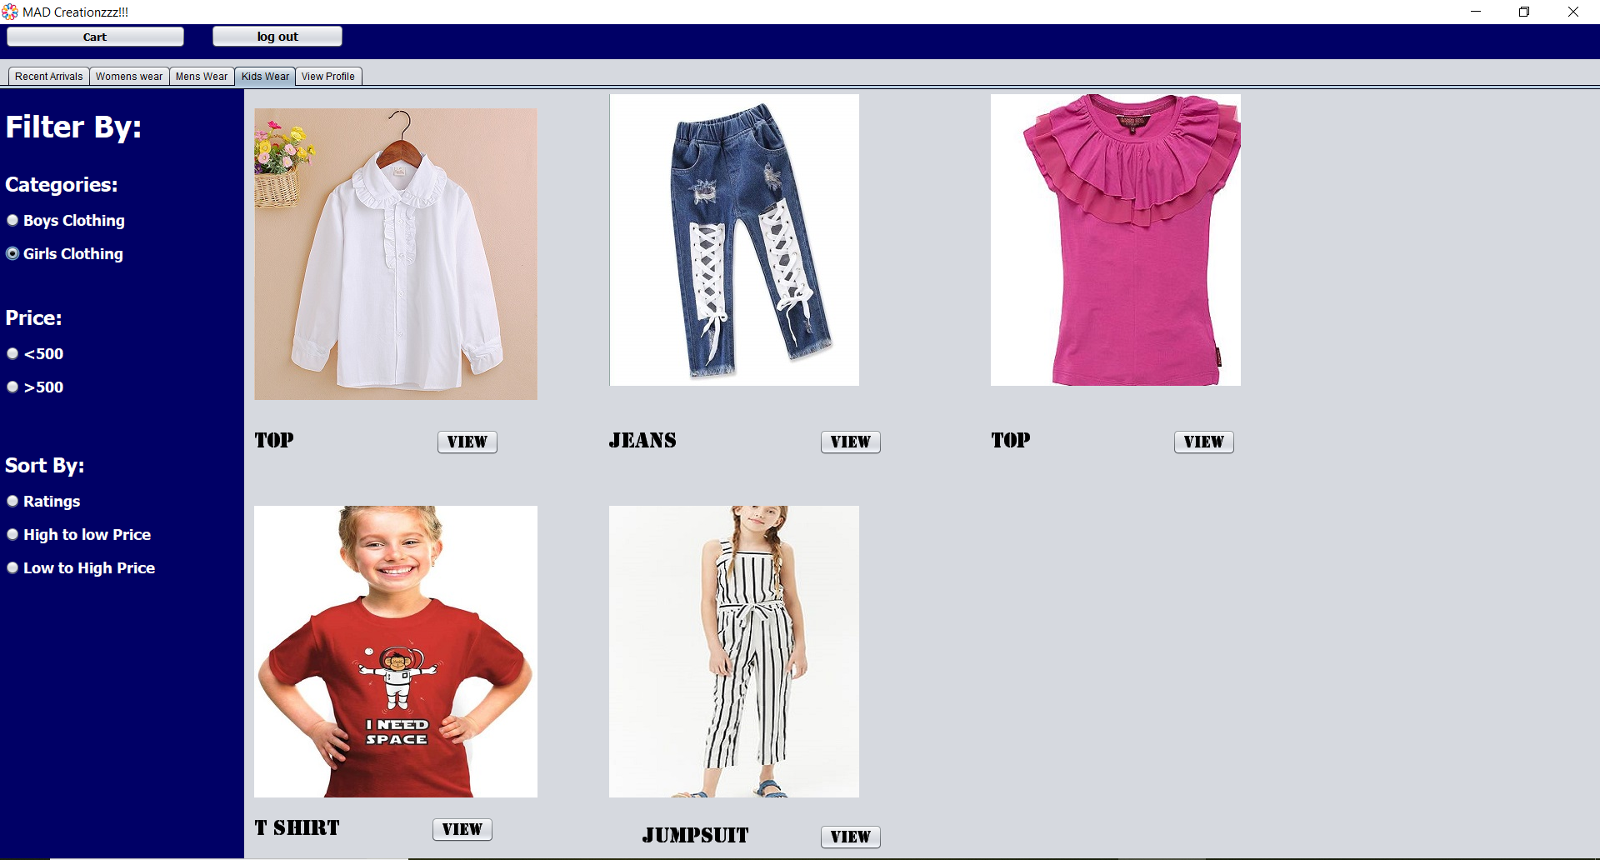
GUI/Screen Design
Kids’ Wear Screen

Slide 27
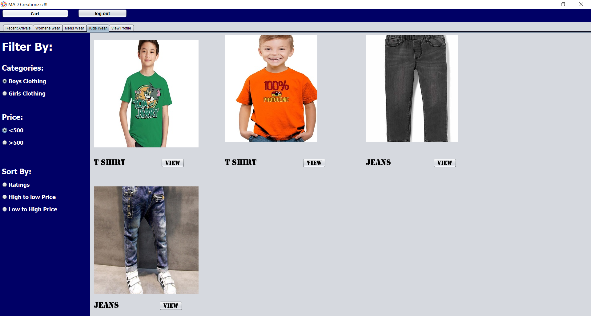
GUI/Screen Design
Kid's Wear Screen

Slide 28
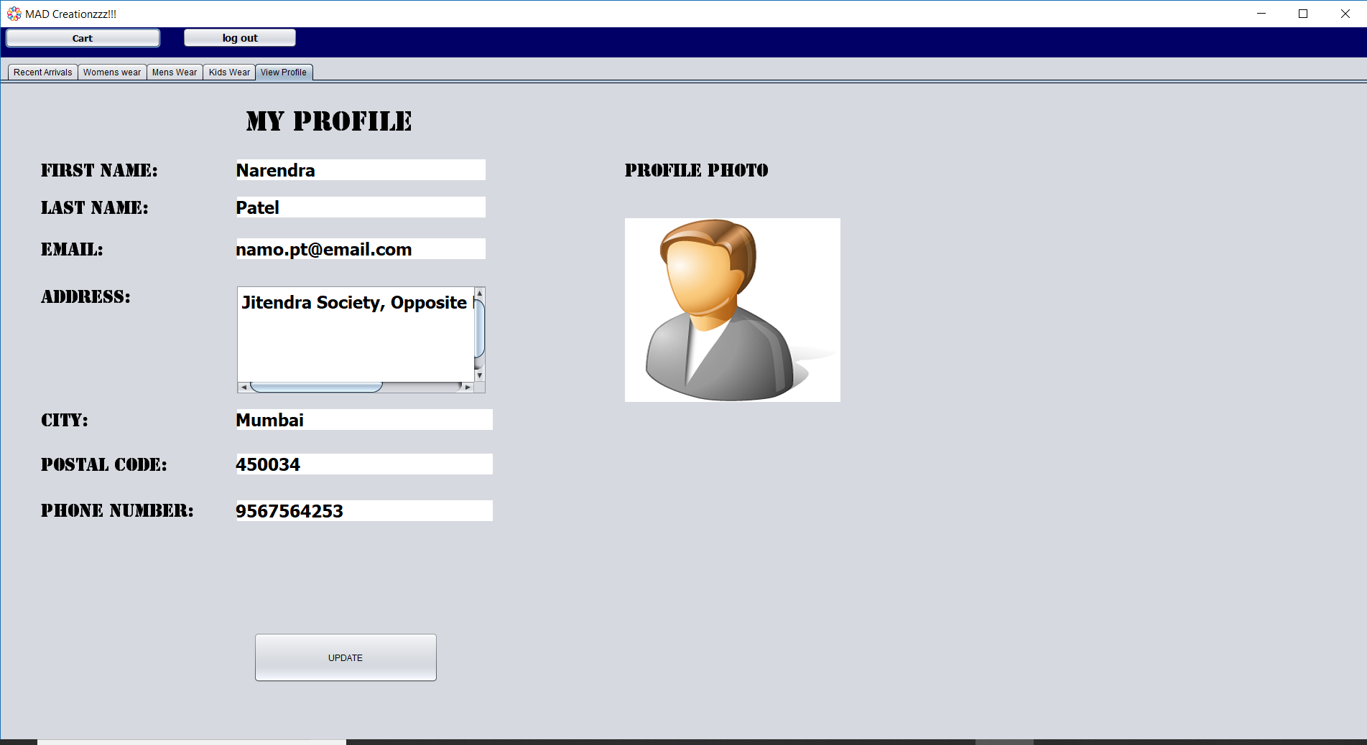
GUI/Screen Design
View Profile Screen

Slide 29
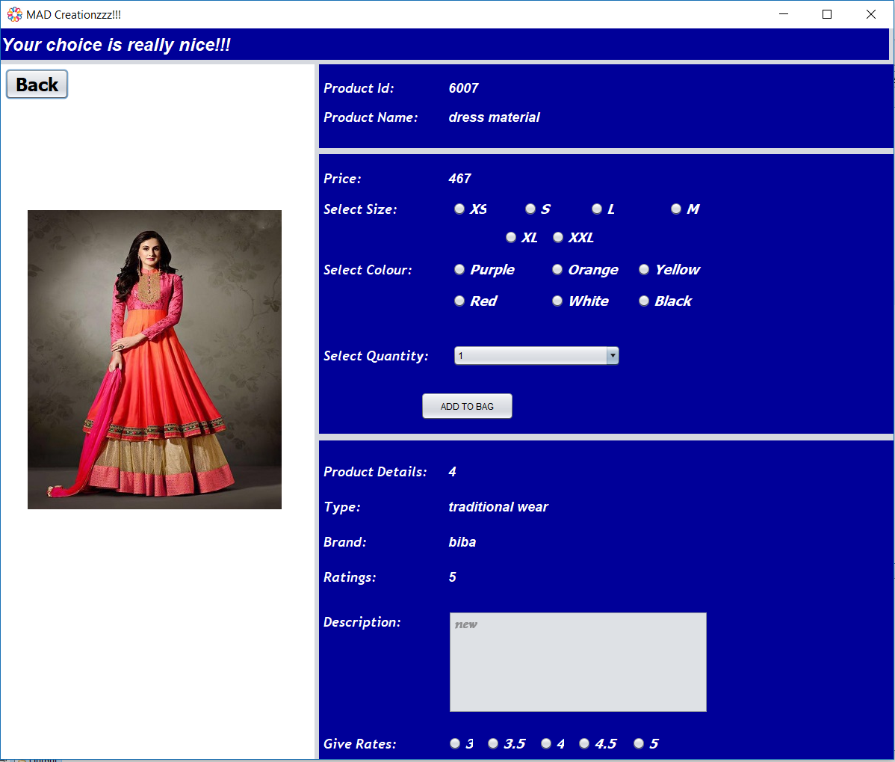
GUI/Screen Design
Product Details Display Screen

Slide 30
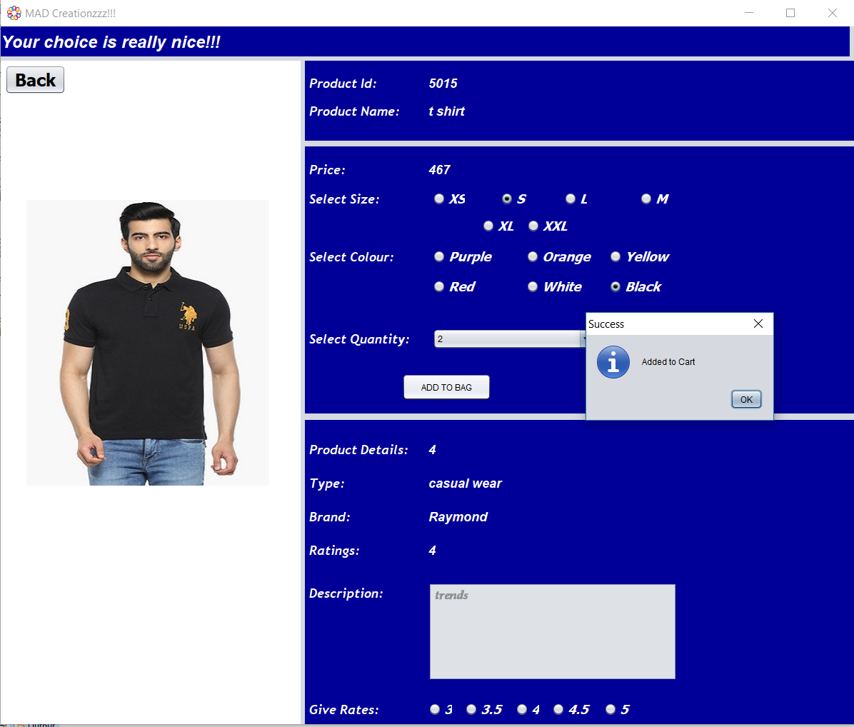
GUI/Screen Design
Product Details Display Screen

Slide 31
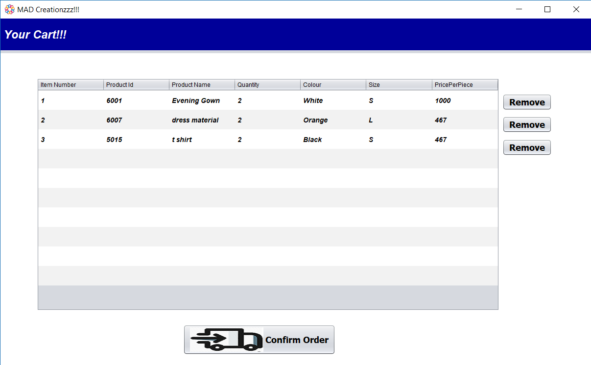
GUI/Screen Design
Cart Display Screen

Slide 32
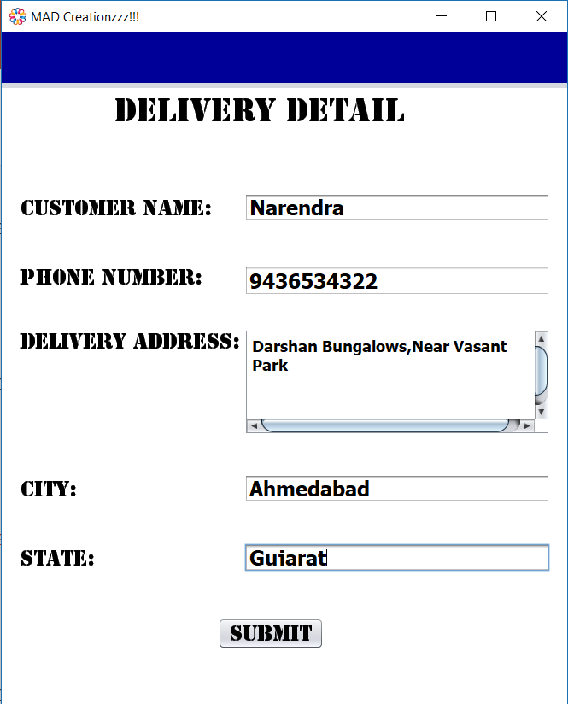
GUI/Screen Design
Address Fill-Up Screen

Slide 33
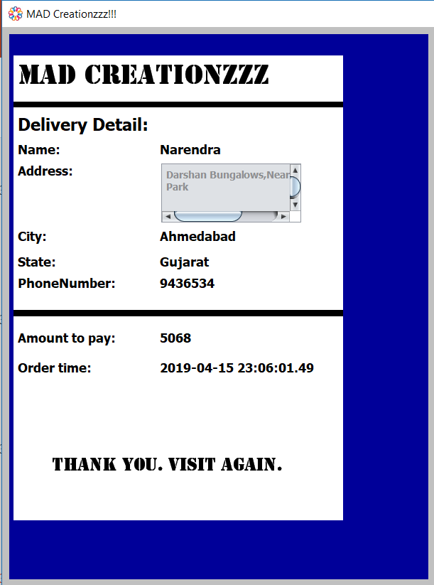
GUI/Screen Design
View Bill Screen

Slide 34
Thank You!!!

